Slide 1
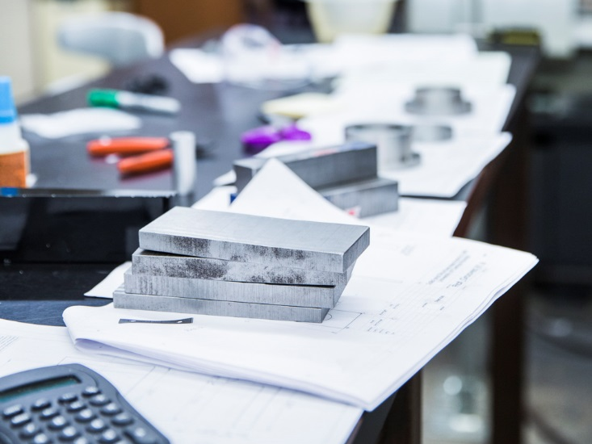
Off the Lab Bench and into the Marketplace:
TECHNOLOGY COMMERCIALIZATION AT UCF
Svetlana Shtrom, PhD, MBA

Slide 2
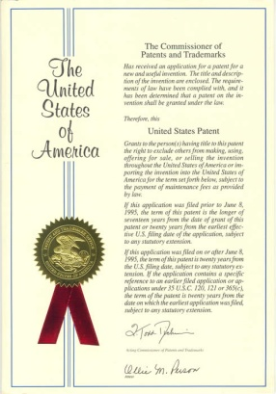
Office of Technology Transfer
We protect, market and license University’s intellectual property
Our services include:
Management of intellectual property
Strategic transfer of inventions and works to marketplace
Interfacing with industry, investors, and entrepreneurs
Negotiation of partnership agreements
Education in technology commercialization and entrepreneurship
UCF Venture LaunchTM

Slide 3
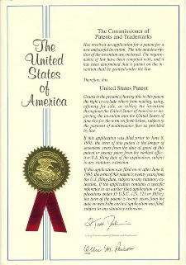
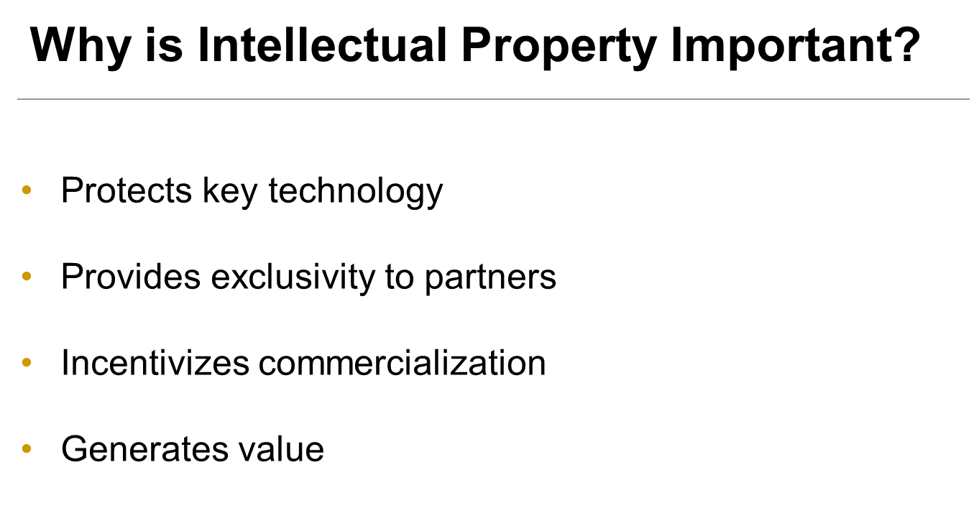

Slide 4
University Licensing Income*
Institution | Annual Royalties ($)
U Texas System | 362,712,828
Sloan Kettering | 265,284,478
City of Hope | 165,523,000
Mass General | 142,906,417
Princeton | 134,338,003
Mayo Foundation | 117,885,888
Stanford | 114,022,678
U California System | 107,945,000
Northwestern | 105,321,475
MIT | 87,000,000
*Licensing income for 2020; source: AUTM

Slide 5
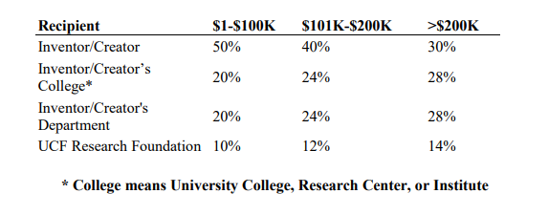
Licensing Income Distribution
Distribution of licensing income follows the standard policy in place at UCF. Cumulative Net Income (gross royalties minus direct costs of patenting, copyright registration, trademark registration, licensing, legal, and other related expenses) resulting from Inventions and Works (excluding books) to which UCF takes title is divided according to the following distribution:

Slide 6
Intellectual Property: UCF Regulations
Intellectual Property Submission/Review
(1) University Personnel are required to disclose to the Office of Technology Transfer all Inventions made in the field in which the Inventor is employed by the University or for which there has been University Support and all Works developed by Creators using University Support;
(2) The Office of Technology Transfer will assess the novelty and marketability of the Inventions and Works and determine the extent to which the University should be involved in protection, development, and promotion of the Inventions and Works;
(3) The Office of Technology Transfer will inform the Inventors and Creators of University's decision within 90 days from the date of receipt of Invention/Work disclosure.
http://collectivebargaining.ucf.edu/CBA/final2019-2021fullbook.pdf
https://regulations.ucf.edu/chapter2/documents/2.029PatentsTrademarksSecretsFINALJune21.pdf
https://regulations.ucf.edu/chapter2/documents/2.033CopyrightsandWorksFINALDec2020.pdf

Slide 7
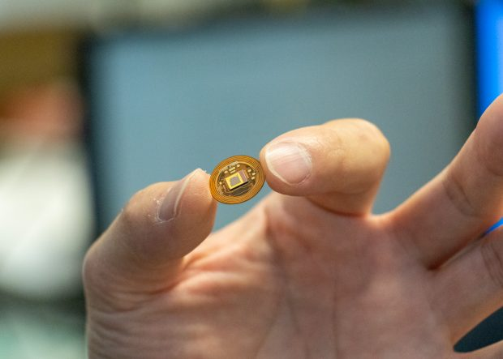
Path to Commercialization
Invention/Work
Inventors
IP Assessment/Patent Strategy
Technology Commercialization Committee
Market and Business Analysis
Inventors
Commercialization Strategy
Coaching
Start-Up
External Company
Incubation

Slide 8
Office of Technology Transfer
-FY2021 At a Glance-
$211.4 million
111
Our dedicated team of professionals works to bring UCF discoveries to the marketplace through intellectual property protection, marketing
and licensing and connects researchers with companies and entrepreneurs to transform innovative ideas into successful products.
Research
Funding
Invention
Disclosures
Research &
Development
Invention
30
Start-ups Still
Operational
as of FY 2021
Invention
Public Use
and Economic
Growth
Public Use
and Economic Growth
Evaluation
Evaluation
Technology Transfer Lifecycle
FY 2021
Evaluation
Product Development
114
Total U.S. Patent Applications Filed
Product
Development
21
Products
on the
Market
IP Protection
IP Protection
Licensing
Licensing
Marketing
1,057
Total U.S. patents secured through FY 2021
Marketing
64
29
U.S. Patents
Issued
Licenses & Options Executed
Adapted from AUTM with permission. www.autm.net

Slide 9
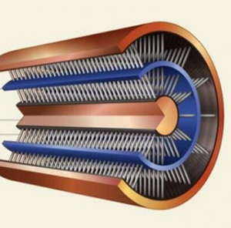
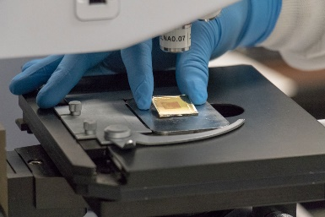
Off the Lab Bench and into the Marketplace:
Achieving Success Together
Key drivers:
Valuable intellectual property
Commercial partners
Effective technology transfer
Successful R&D and commercialization
Factors that impact IP validity and value:
Protection before publication
Correct inventorship and funding
Disclosure of material references
Broad protection

Slide 10
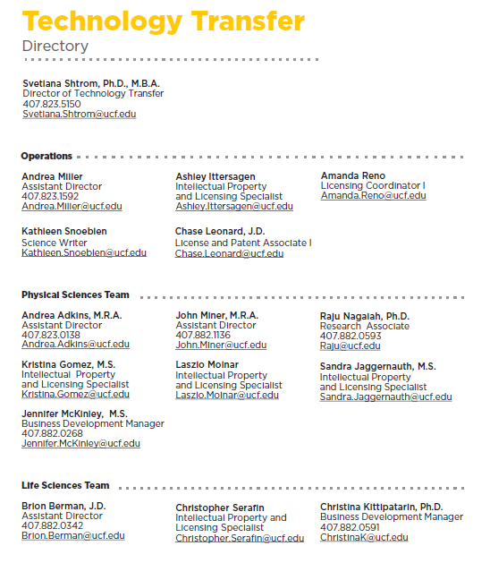
Technology Transfer Directory
Find your IP Specialists here:
https://tt.research.ucf.edu/find-ip-team/

Slide 11
My Contact Information
Svetlana Shtrom, PhD, MBA Director, Technology Transfer
Phone (407) 823-5150
Email: sshtrom@ucf.edu
University of Central Florida University Tower/Research Park 12201 Research Parkway, Suite 202 Orlando, FL 32826

Slide 12
Supplemental Information:
Strategic IP Review, Protection, Marketing,
and Licensing

Slide 13
Path to Commercialization
Invention/Work
Inventors
IP Assessment/
Protection Strategy
Technology Commercialization Committee
Market and Business Analysis
Inventors
Commercialization Strategy
Coaching
Start-Up
External Company
Incubation

Slide 14
Path to Commercialization
Invention/Work
Inventors
IP Assessment/
Protection Strategy
Technology Commercialization Committee
Market and Business Analysis
Inventors
Commercialization Strategy
Coaching
Start-Up
External Company
Incubation

Slide 15
Invention
-any art or process (way of doing or making things), machine, manufacture, design, or composition of matter, or any new and useful improvement thereof, or any variety of plant, which is or may be patentable under the patent laws of the United States

Slide 16
Work of Authorship
-"original works of authorship" include literary, dramatic, musical, architectural, cartographic, choreographic, pantomimic, pictorial, graphic, sculptural, and audiovisual creations

Slide 17
Path to Commercialization
Invention/Work
Inventors
IP Assessment/
Protection Strategy
Technology Commercialization Committee
Market and Business Analysis
Inventors
Commercialization Strategy
Coaching
Start-Up
External Company
Incubation

Slide 18
Invention / Work Assessment
Regulatory requirements
Invention reporting
Government rights
Technology/IP
Novelty
Breadth
Advantage
Market
Size
Competition
Potential partners
Research funding needs
ORC: http://www.research.ucf.edu/funding_assistance.html
Invention Protection
Patent
Copyright
Trademark
Possible commercialization paths
Faculty led start-up
External company
Inventors
IP Assessment/ Protection Strategy

Slide 19
Review / Protection Decision
Inventors
IP Assessment/
Protection Strategy
Technology Commercialization Committee
YES
NO
File for protection and advertise
Waive to Inventor
Abandon
Market and Business Analysis

Slide 20
Path to Commercialization
Invention/Work
Inventors
IP Assessment/
Protection Strategy
Technology Commercialization Committee
Market and Business Analysis
Inventors
Commercialization Strategy
Coaching
Start-Up
External Company
Incubation

Slide 21
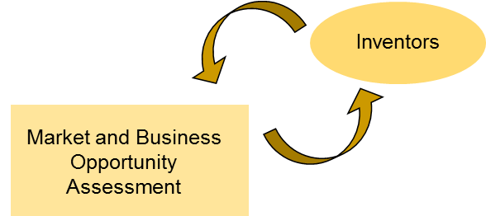
Market and Business Analysis
Technology development
Stage
Prototyping
Inventor commitment
Funding needs
Grants (SBIR/STTR)
Matching funds
Investors
Business Opportunity (I-Corps)
Business model development
Customer validation
Problem – Solution fit
Product – Market fit
Market
Opportunity
Size
Impact
Competitive landscape
Technology
Applications
Partnership options
Industry
Barriers to entry
Regulatory implications

Slide 22
Commercialization Strategy Decision
Inventors
Market and Business Opportunity Assessment
Commercialization Strategy
Coaching
Start-Up
External Company
Incubation

Slide 23
My Contact Information
Svetlana Shtrom, PhD, MBA Director, Technology Transfer
Phone (407) 823-5150
Email: sshtrom@ucf.edu
University of Central Florida University Tower/Research Park 12201 Research Parkway, Suite 202 Orlando, FL 32826

